Slide 1

Dorcas Matsi (General Manager) and Kabelo Maleka
Presenting
ConnectRecycle – Mobile Application

Slide 2
WHAT PROBLEM ARE WE SOLVING
Community discarding waste in appropriately.
Waste management dealers not easily having access to the right customers .
THE SOLUTION
ConnectRecycle – Mobile Application
To address inappropriate discarding of waste that have an impact to environmental sustainability.
Notes:
A recycling app that connects customers with dealers can potentially solve the following problems:
Convenience: Such an app makes it easier for customers to dispose of recyclable items, as they can locate and communicate with dealers directly from their smartphones. This reduces the time and effort required to dispose of recyclables, promoting a more efficient and eco-friendly waste management system.
Transparency: The app can promote transparency in the recycling process by providing users with information about their local recycling dealers, such as their recycling capabilities and rates.

Slide 3
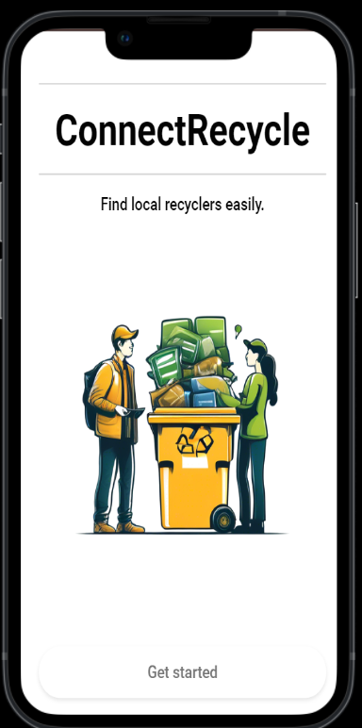
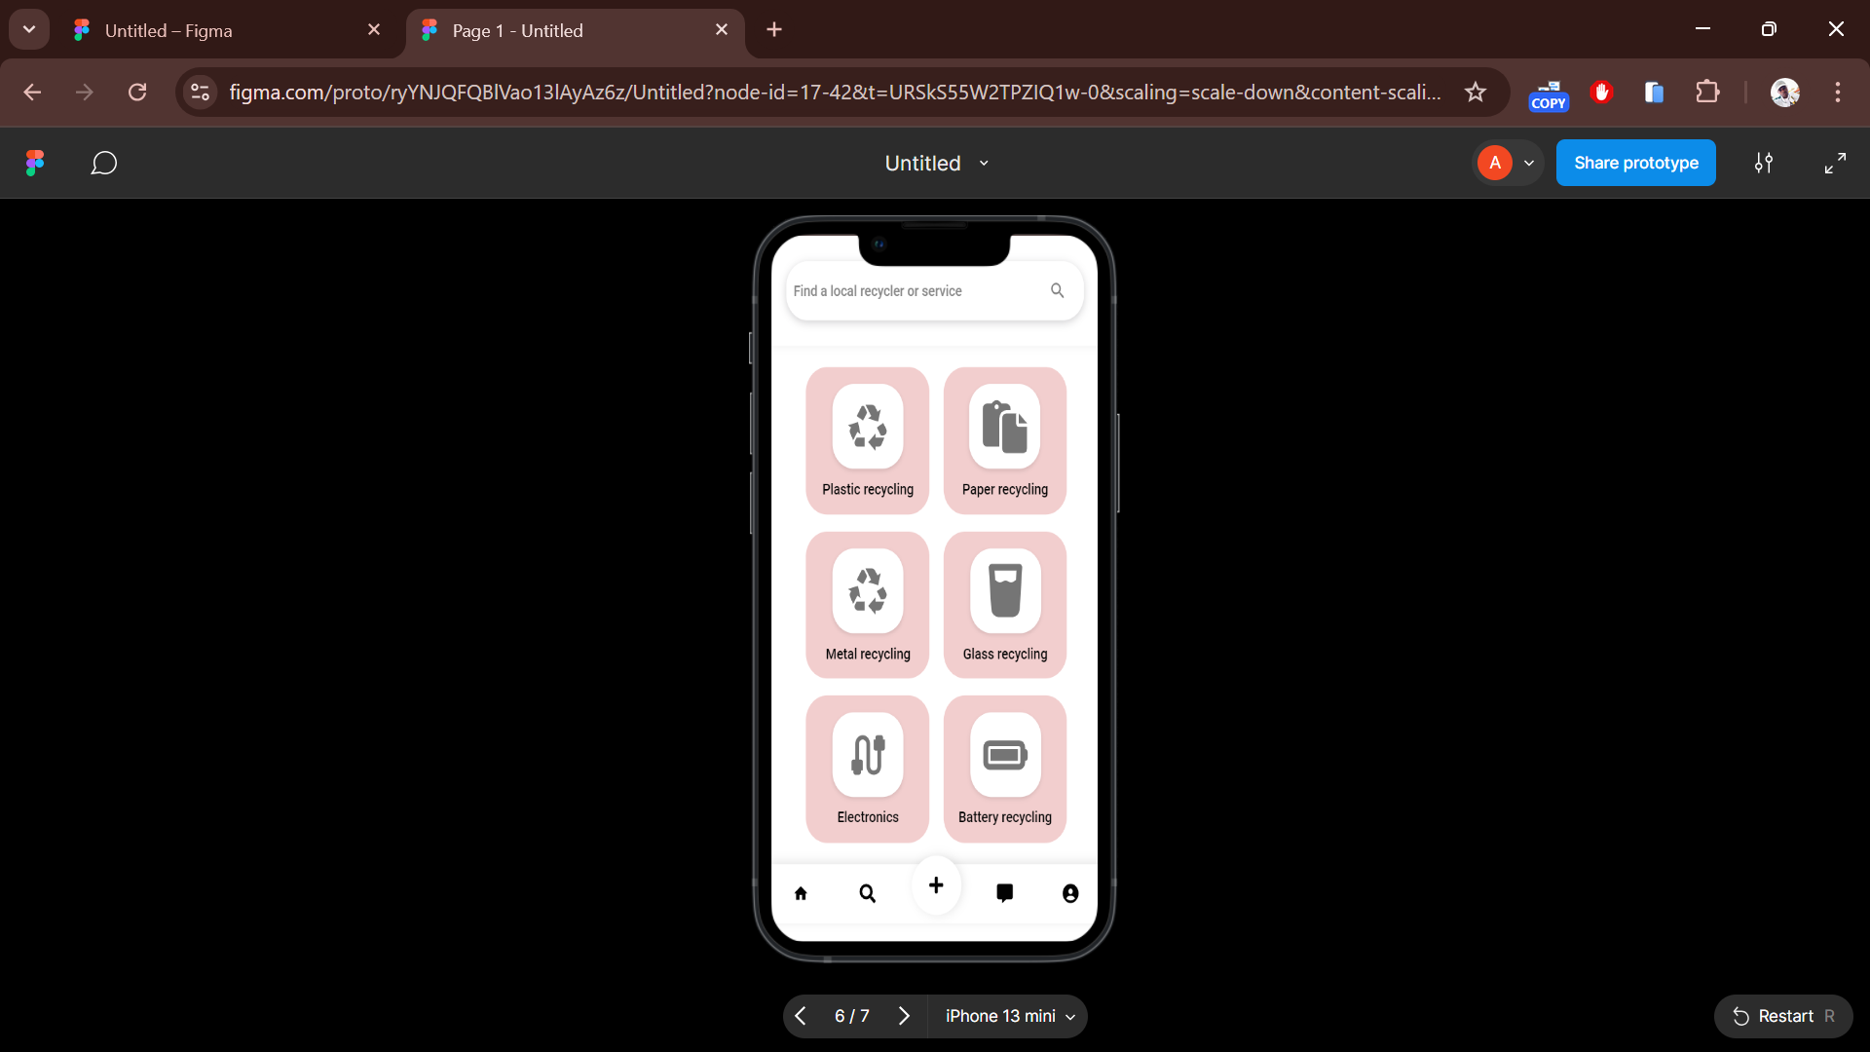
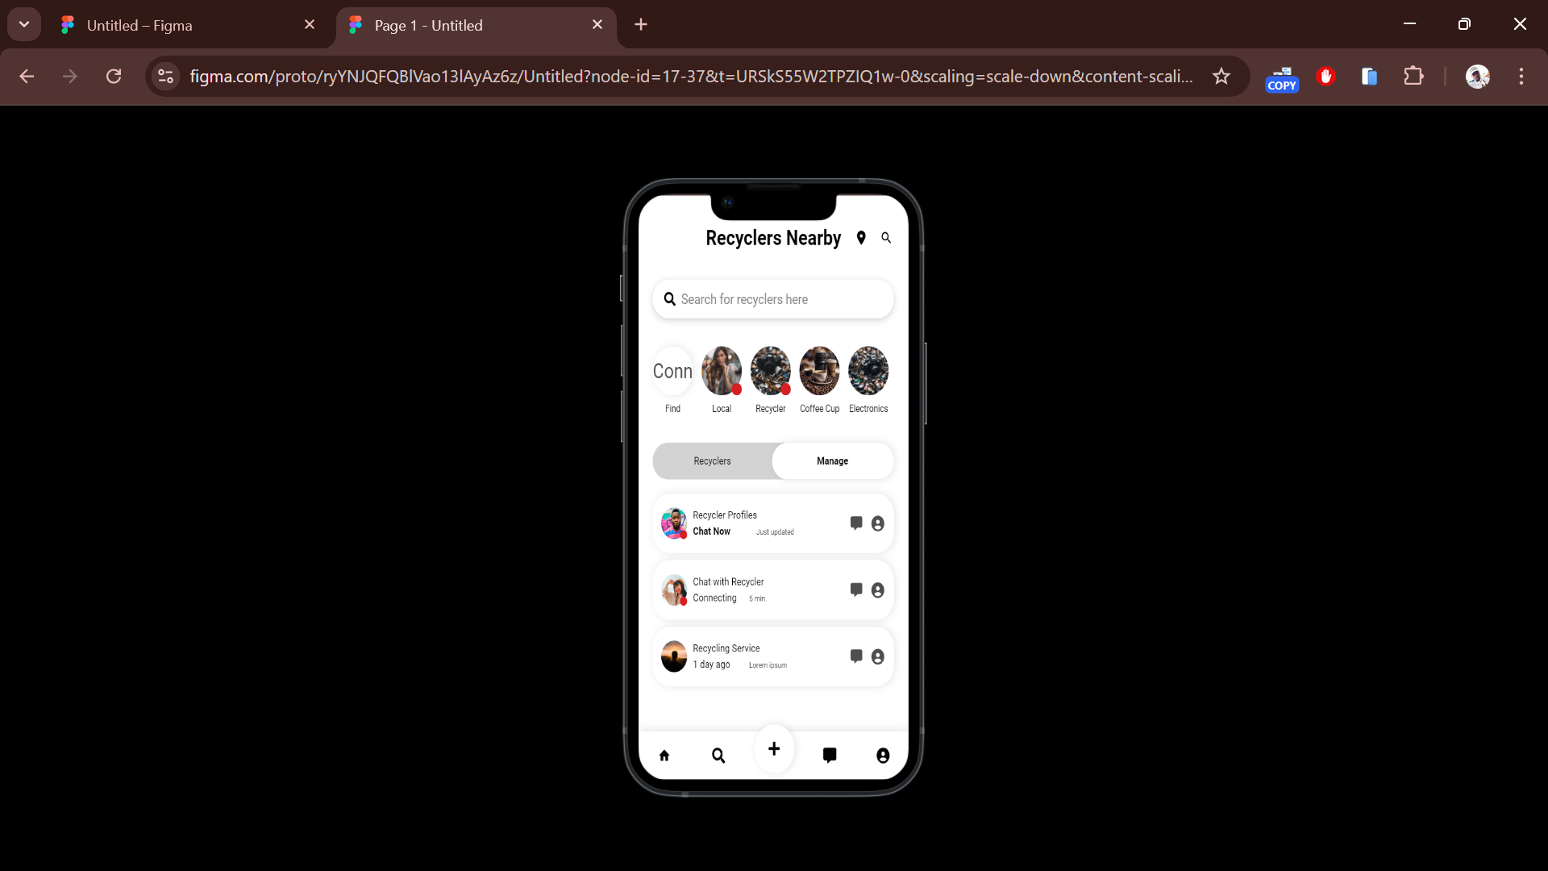
PRODUCT DESCRIPTION
Notes:
PRODUCT DESCRIPTION
Connect with people that offer plastic waste, via in-app chat message and schedule a meeting for collection at your comfortable time.

Slide 4
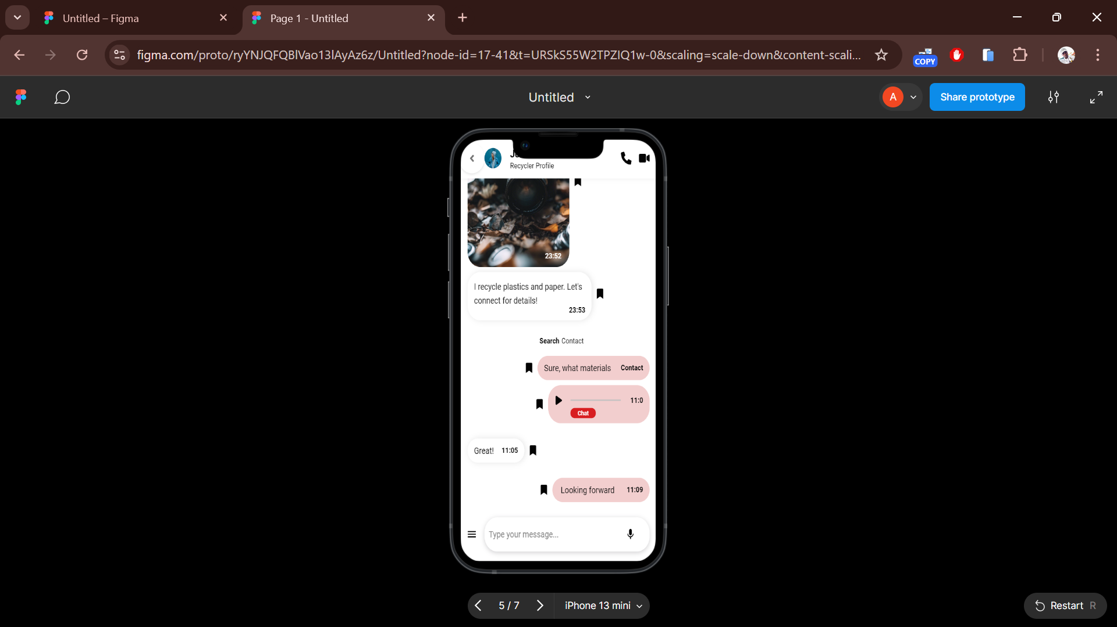
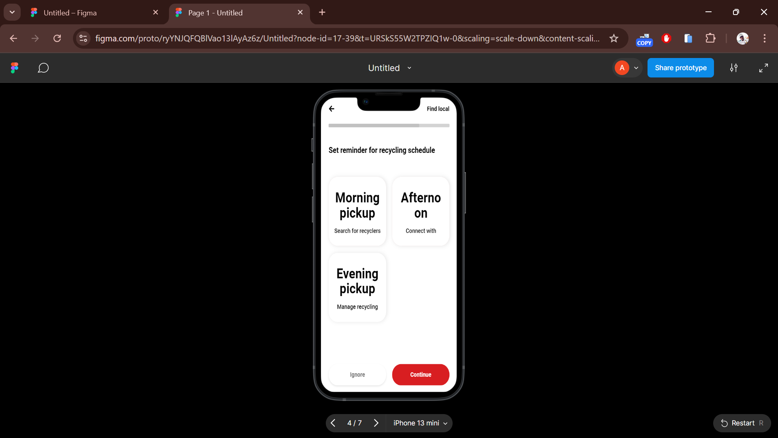
WHAT MAKES IT UNIQUES AS COMPARED TO COMPETITORS
Easy communication!
Chat
Select pick-up time
Convenience!
Easier for customers to dispose off recyclable items, by locating the dealer.
Transparency!
Promote awareness to the user of information about their local recycling dealers.
Notes:
Convenience: Such an app makes it easier for customers to dispose of recyclable items, as they can locate and communicate with dealers directly from their smartphones. This reduces the time and effort required to dispose of recyclables, promoting a more efficient and eco-friendly waste management system.
Transparency: The app can promote transparency in the recycling process by providing users with information about their local recycling dealers, such as their recycling capabilities and rates.

Slide 5
TARGET MARKET
Community households: homeowners and renters.
Local business : Small businesses, cafes and other commercial entities that have recyclable waste.
Schools, TVET Colleges and Universities: to promote sustainable practices among the students and staff.
Notes:
The virtual science lab app could cater to several target markets:
K-12 students: The app can be utilized as a tool for science education in schools, aiding students in grasping complex scientific concepts and conducting experiments in a safe and controlled environment.
University students: College-level students could benefit from using the app for practice and experimentation, particularly in cases where physical lab facilities are limited.
Homeschooling families: Home educators could leverage the app as an engaging resource to supplement their science curricula.

Slide 6
CAPITAL CONTRIBUTION
The 16 members each contributed R50, resulting in a total startup capital of R800.

Slide 7
COST STRUCTURE
VARIABLES COST
Maintenance and upgrade = R13 500
FIXED COST
Design and development
= R80 500
SELLING PRICE
Subscription of R15 per registration of an individual.
Subscription of R60 registration of a company and waste management dealer.
Notes:
Cost structure derived from Top Development App companies

Slide 8
BREAK-EVEN POINT
Break-Even point = Total Fixed Costs
contribution margin per unit
R 80 500
R60
1341.6 UNITS
We need 1342 subscribers

Slide 9
COMPANY FINANCIAL STATEMENT
Statement of Profit and Loss for end of July 2024
Income | 3380
Less Cost of Sales) | 1898.00
Gross Profit | 1482
Less Operating expenses
Transportation | 252.00
Equipment hire | 20.00
Net Profit income | 1210
Statement of Financial Position as at end July 2024
 | R
ASSETS
Inventory (Raw materials) | 0
Cash and cash equivalents | 1210
TOTAL ASSETS | 1210
EQUITY AND LIABILITIES
Total Equity | 1210
Share capital | R800
Retained earnings | 410
Total Liabilities
Dividends payable
Other operating cost payable
TOTAL EQUITY AND LIABILITIES | 1210

Slide 10


MARKETING
Promoting the App at the local events such as community meetings.
Use social media platforms.
Place posters at the schools and shopping centers’ notice boards.

Slide 11
FUTURE POTENTIAL OF THE COMPANY
Partner with eco-friendly businesses to increase brand awareness and attract new users.
Engaging the young grades into recycling, by offering them tips.

Slide 12
PROJECT MANAGEMENT SKILLS
Initiation stage
Planning stage
Execution and monitoring stage
Closing stage
At the end of the fundraising event we recalled any mistakes done, so not to repeat it.
Organise raw materials and production
Appointment of the project manager, and deciding on what we will produce and sell for fundraising.
Brainstorming ideas to raise funds for our company.

Slide 13


THANK YOU!!
Entrepreneurship Development Trust Ninety-one

